Slide 1

Cyber Pup: Cybersecurity Awareness Game for Middle School Students
Dr. Shanon Beck
Associate Professor
Department of Computer and Cyber Sciences
1

Slide 2

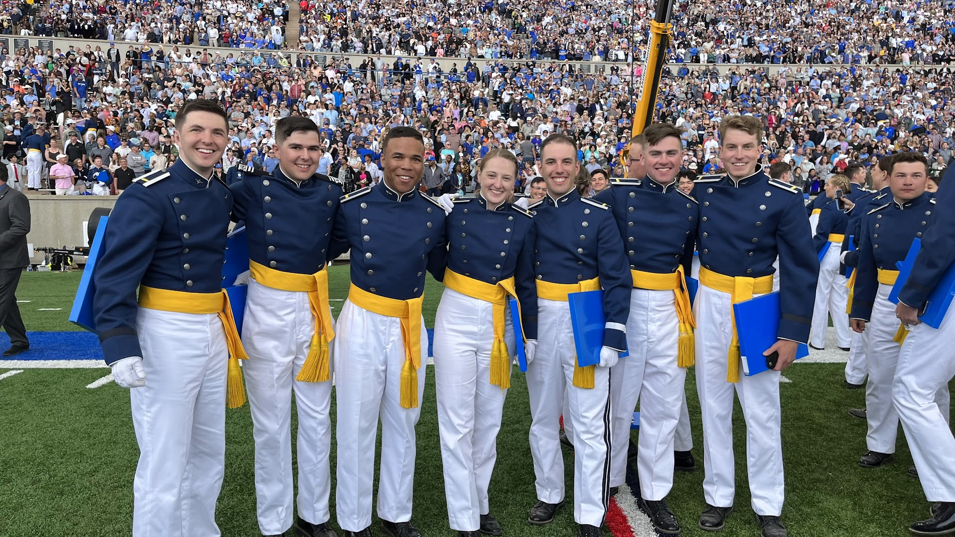
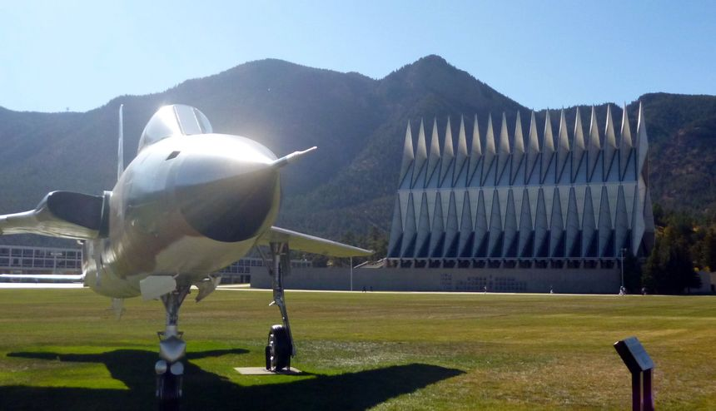
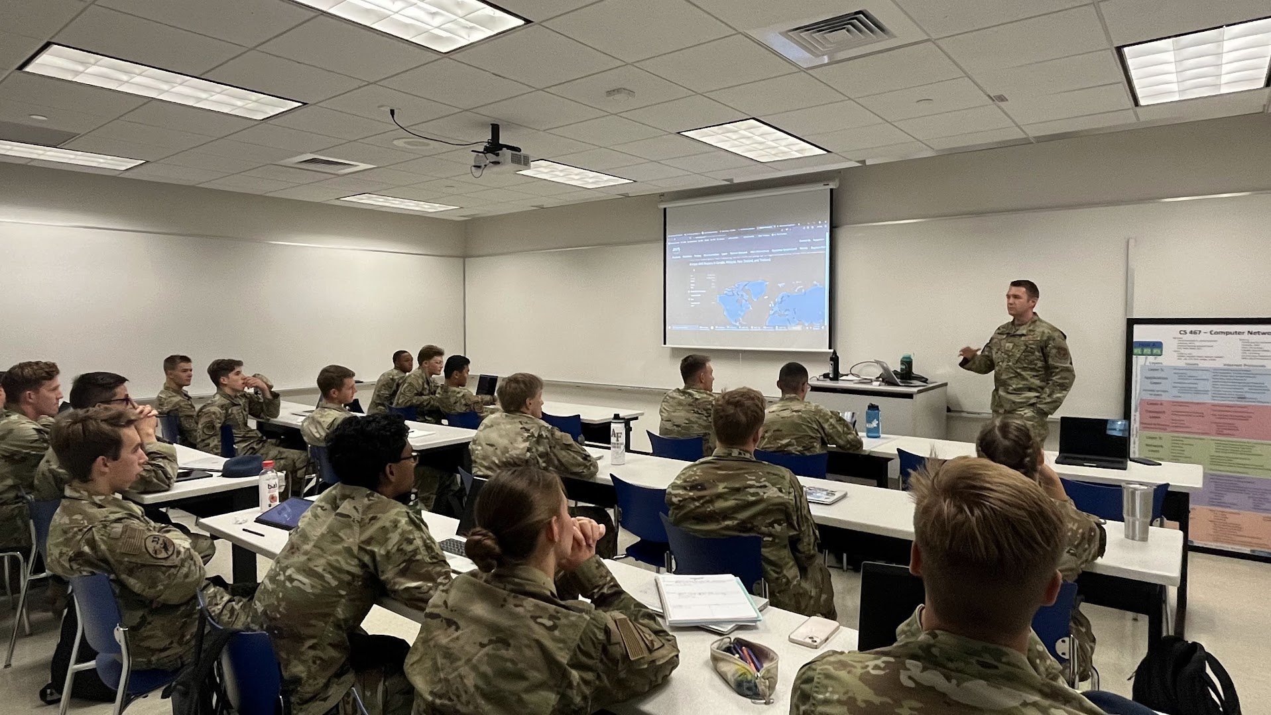
USAFA–Colorado Springs

Slide 3

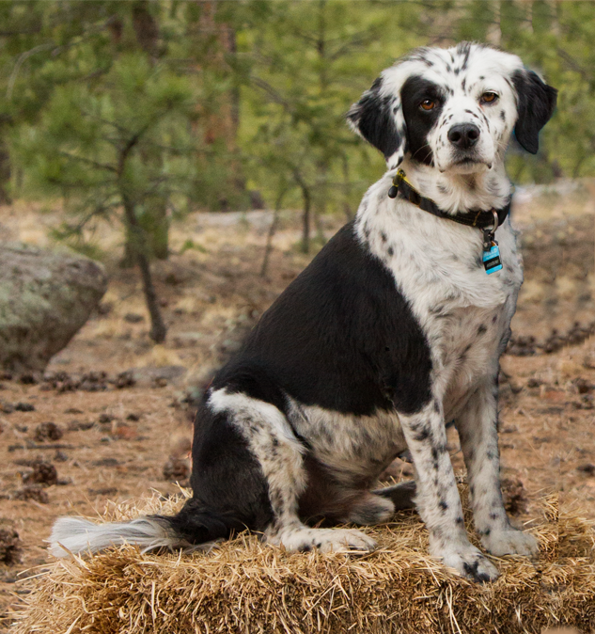
Cyber Pup

Slide 4





Places Prior to the Academy

Slide 5
Mission
Combine gamification + cybersecurity + education → create new experience for learners
Support cybersecurity awareness
Targeting less technical / less confident middle school students
Inclusive towards all, including females and minorities
Vital: >500,000 cybersecurity job openings in this year, jobs are available for those who possess the skills* (CyberSeek.org)

Slide 6
Goals
Create web-based game introducing cybersecurity concepts
Welcoming
Accessible, Inclusive
Dual-language (English and Spanish)
Fun and Engaging
Mini-puzzles → learning pathway for cybersecurity topics
Different levels of difficulty
Working toward more differentiated learning to appeal to differing levels of prior knowledge

Slide 7
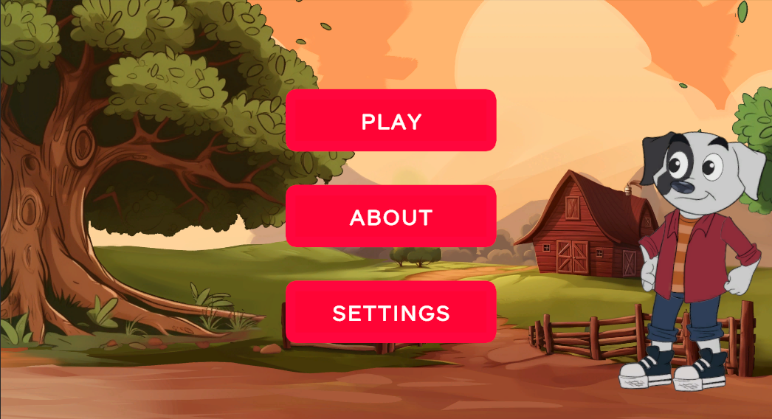
Launch Screen and Menu

Slide 8
Topics Covered (so far)
Simple “encryption” with Caesar cipher
Social media safety
Email safety (click, report, delete)
Binary numbers
Passwords
Strength
Meter (cite)

Slide 9
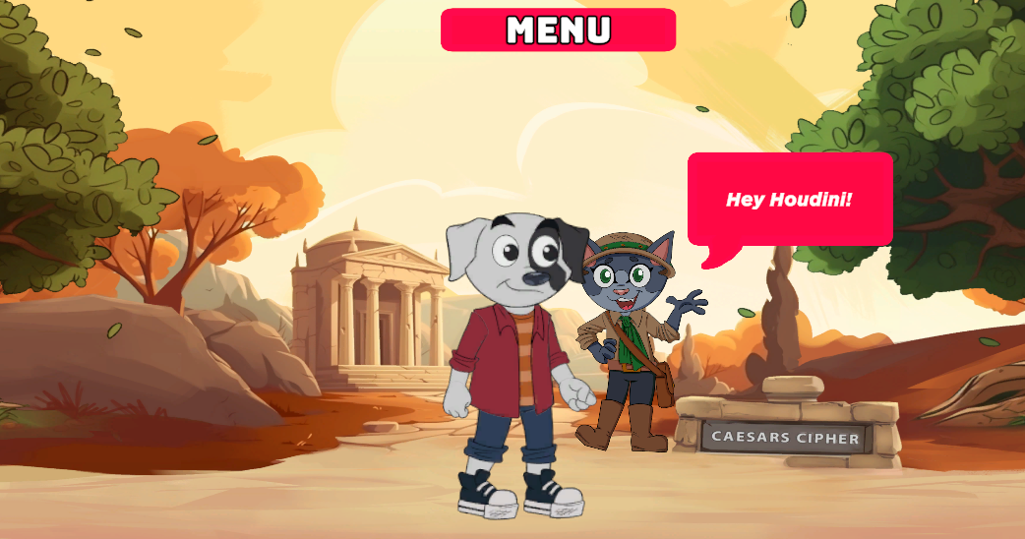
Phineas - Caesar Cipher

Slide 10
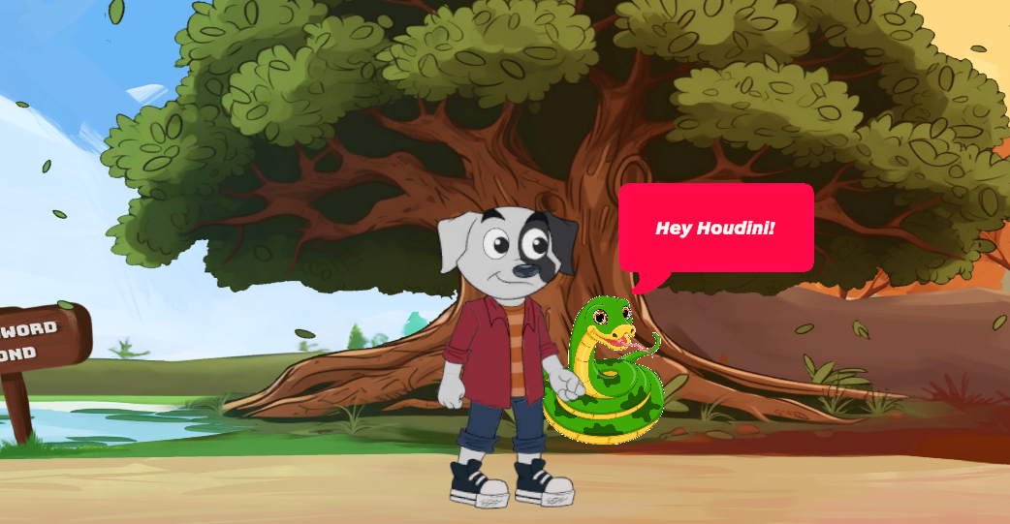
Sly – Social Media Game

Slide 11
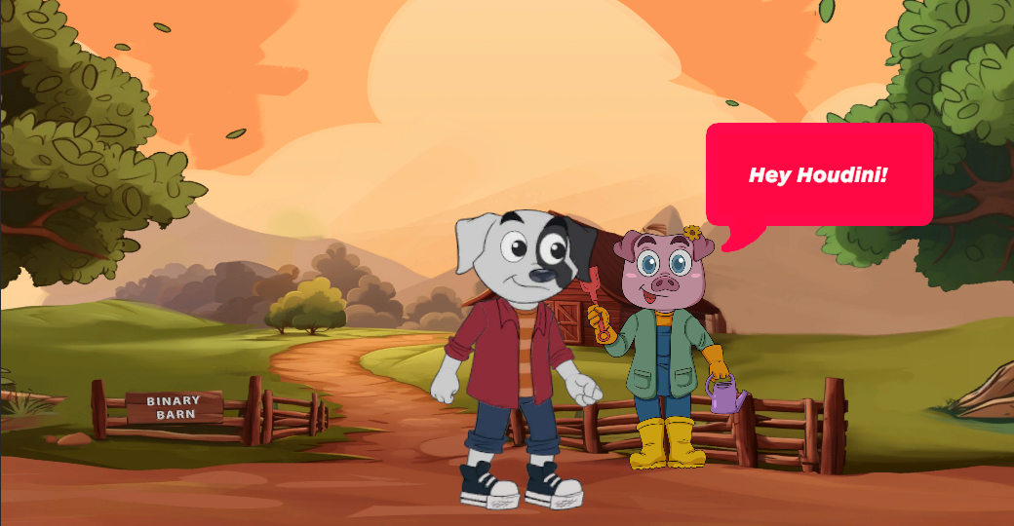
Petunia – Binary Barn

Slide 12
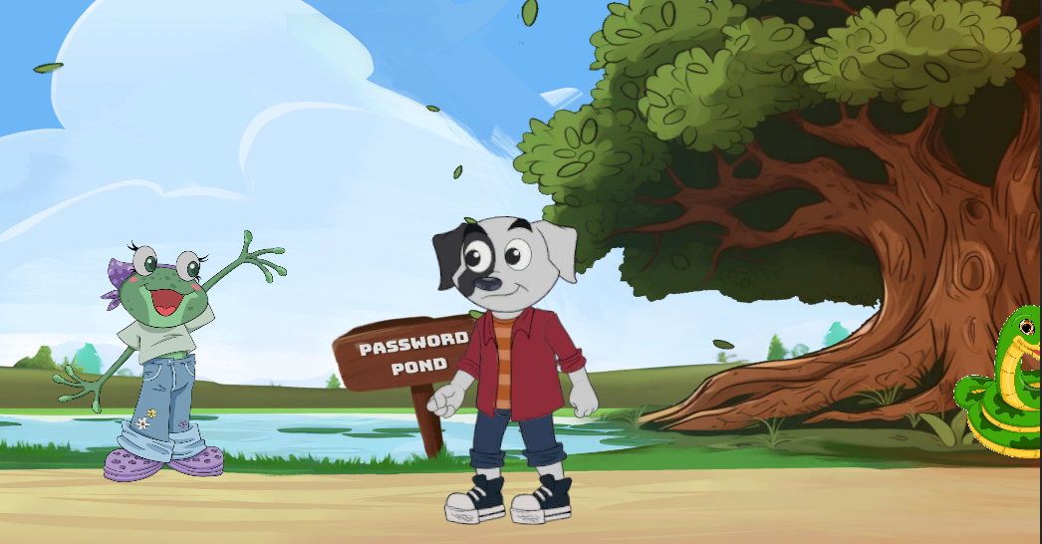
Ellie - Password Pond Two Games: ?’s and Strength Meter

Slide 13
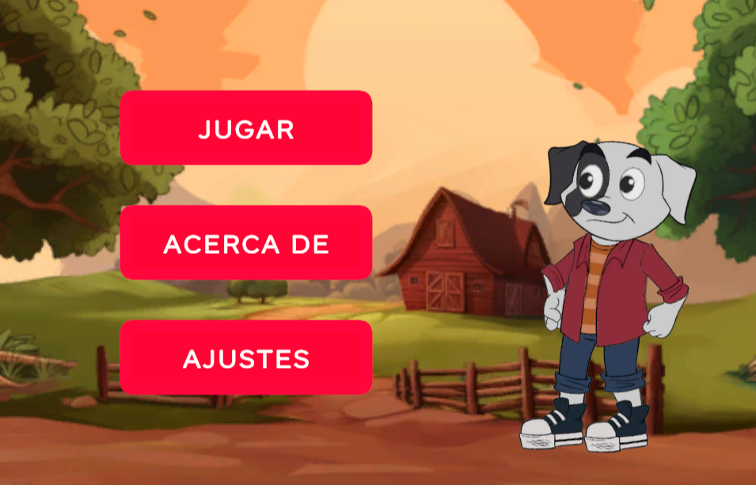
Bi-Lingual Load Screen

Slide 14
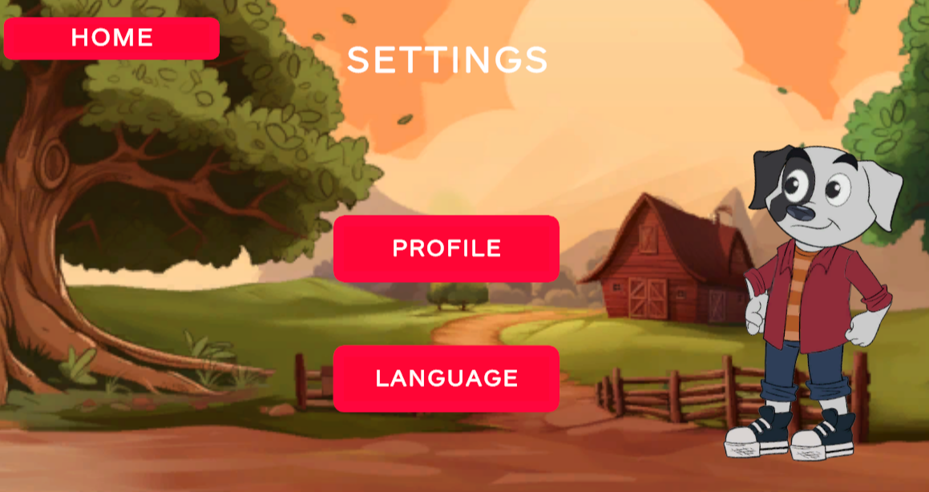
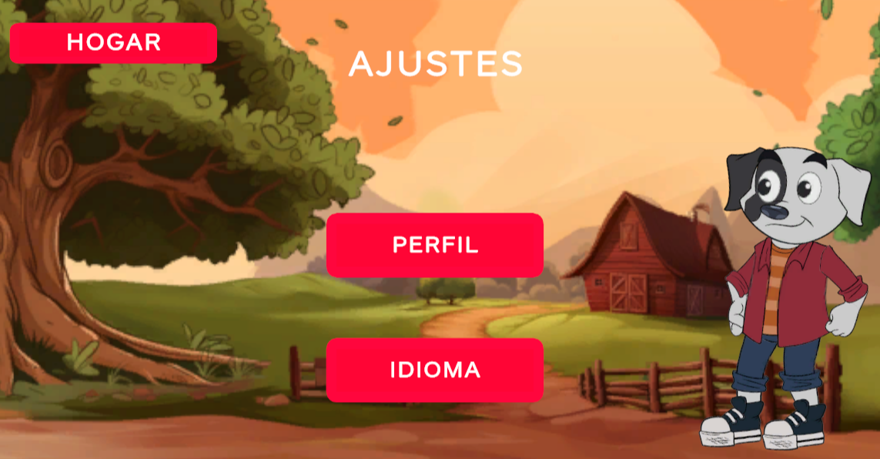
Bi-Lingual Settings Page

Slide 15
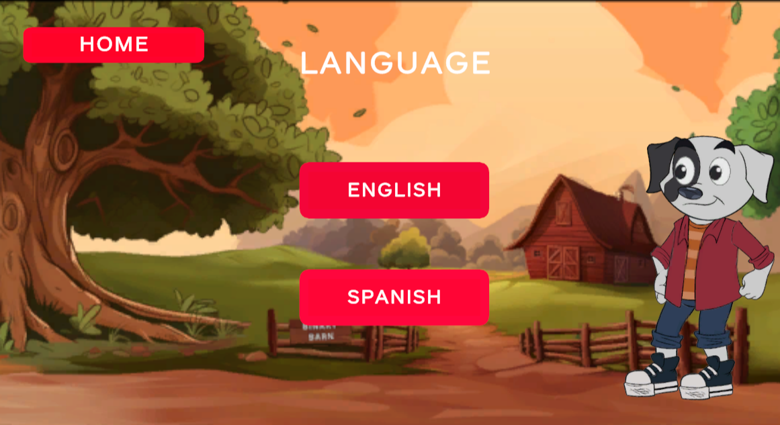
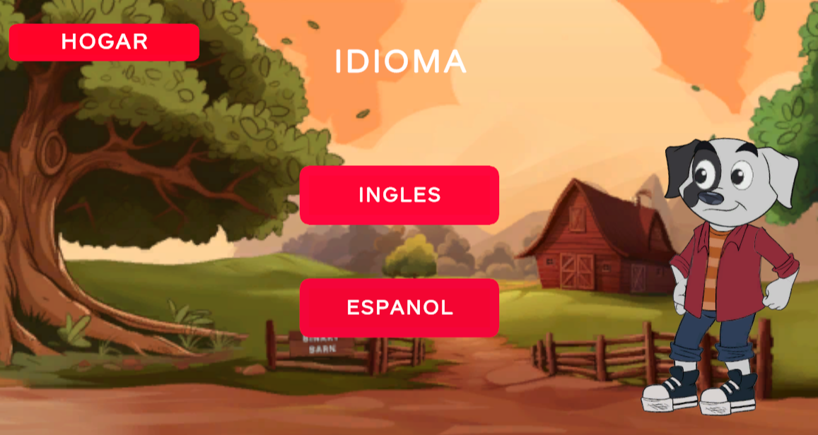
Bi-Lingual Language Selection

Slide 16
Translations
Working to incorporate new translations into games
All text will be available in Spanish and English
Thanks to Cadet Ana Michel Gutierrez

Slide 17
Development
Unity Game Engine
2nd Year: Virtual Student Federal Service (VSFS) Interns
Project-based learning
Many thanks to Gabriella Lowy (GA Tech) and Stephen Hurley (DePaul)!
Accessible
Play on website
No software installs

Slide 18
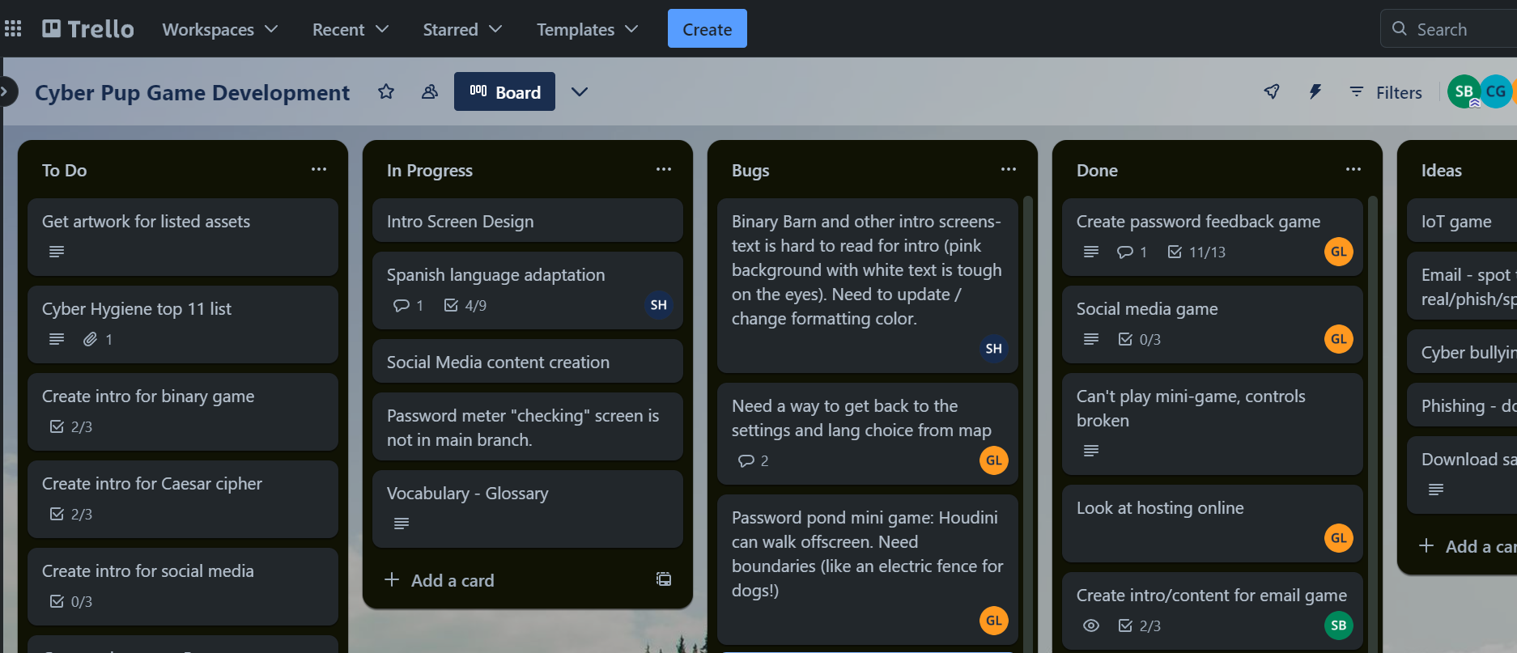
Trello – Agile Development

Slide 19

Caesar Cipher - Encryption

Slide 20
Social Media

Slide 21
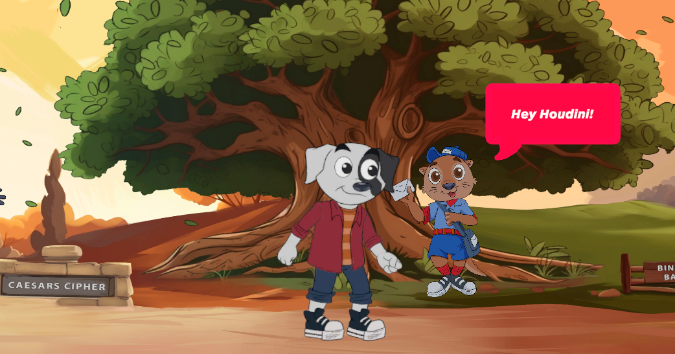
Email Game

Slide 22
Binary Barn

Slide 23
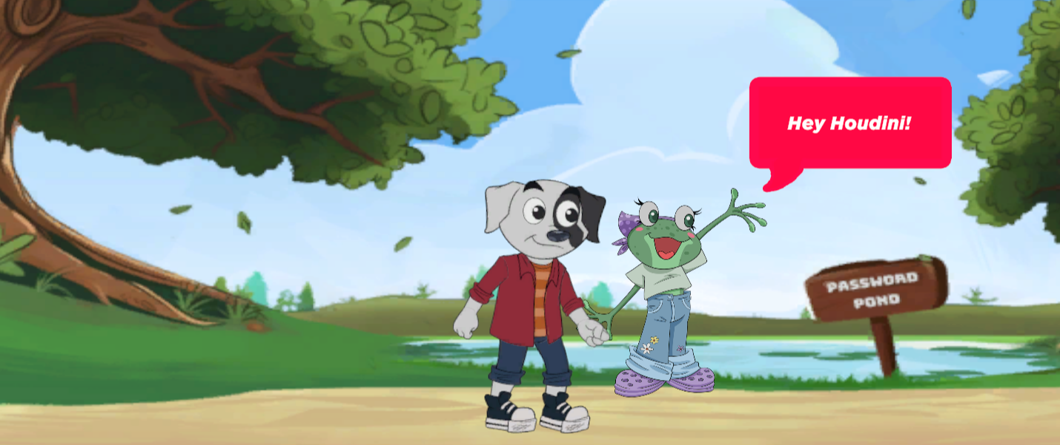
Password Safety

Slide 24
Feedback
Set up feedback form for bug reporting and suggestions

Slide 25
Future Work
Cyber bullying game
Create an escape room scenario
Use skills from the games to navigate out of an escape room
Create a puzzle and skills download and print booklet
Several
https://github.com/shannonbeck/CyberOutreach

Slide 26
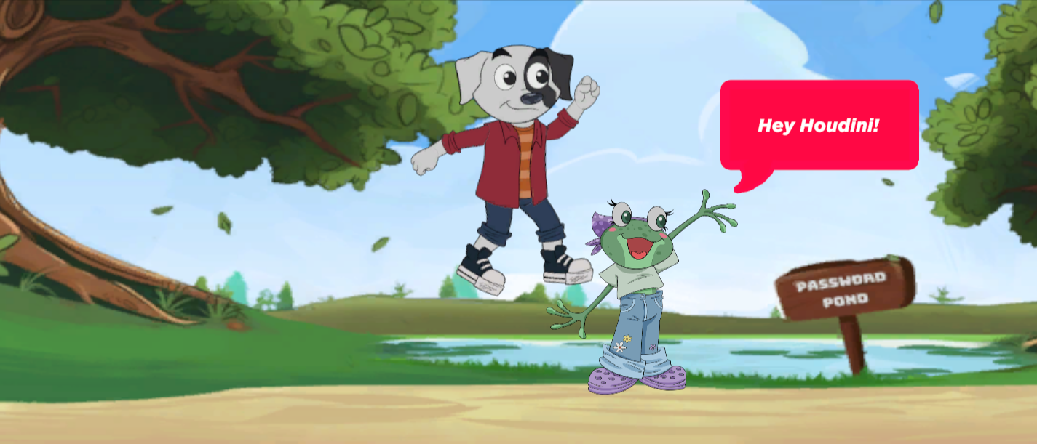
Let’s Play!

Slide 27
Questions

